Slide 1
Assignment 2
Group 1: Adrien Thébault, Vincent Taneli Olander, Nafisa Raihana

Slide 2
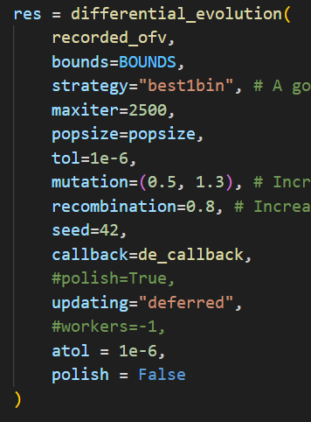
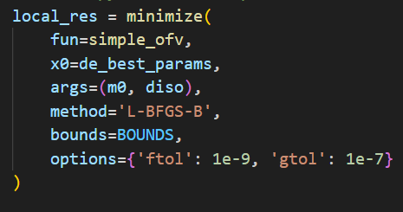
Preconsiderations
Updated first assignment
Adaption of previous errors to allow for better local sensitivity analysis
Logarithmic and clipped y-axis
Maximal evaluations up to 60 000
Adjusted tolerances
More exploration (mutation & recombination)
Initial parameter adapted
Minimization method

Slide 3
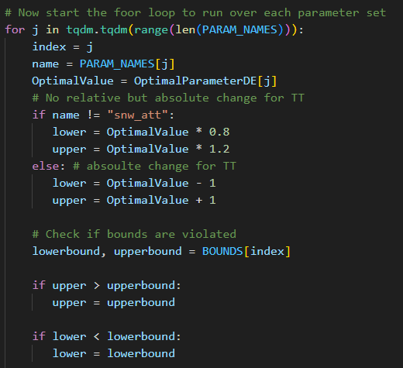
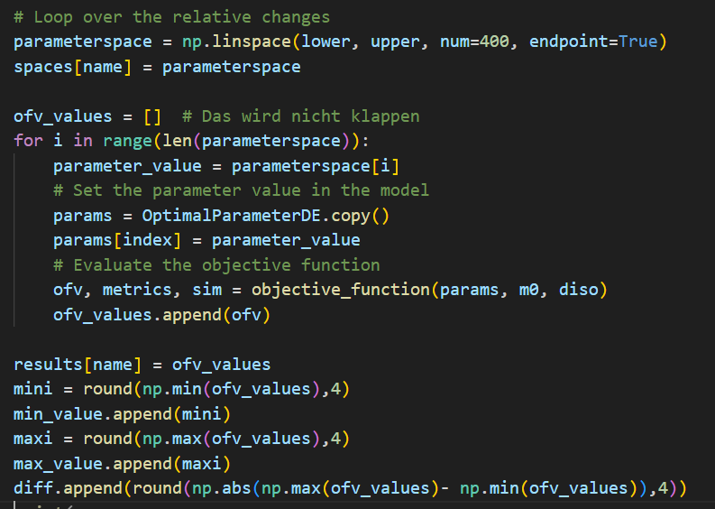
Local Sensitivity Analysis
Implementation

Slide 4
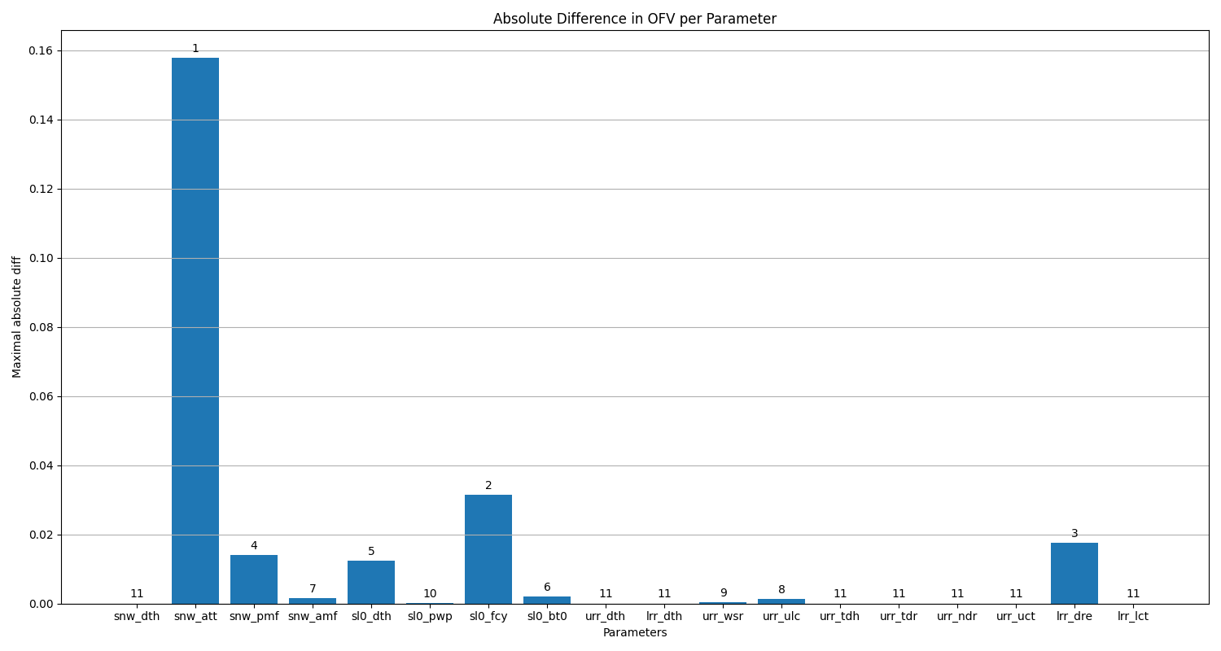
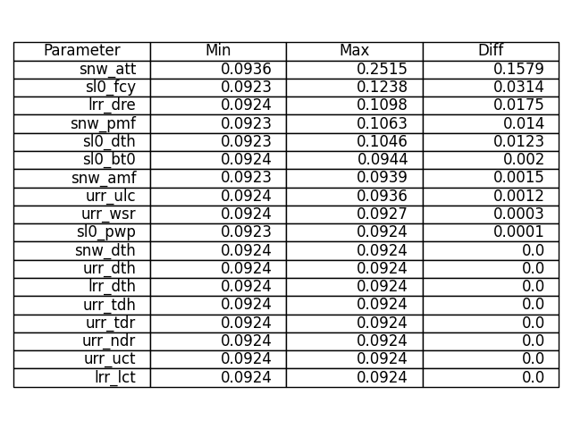
Local Sensitivity Analysis
Result – 20% deviation

Slide 5
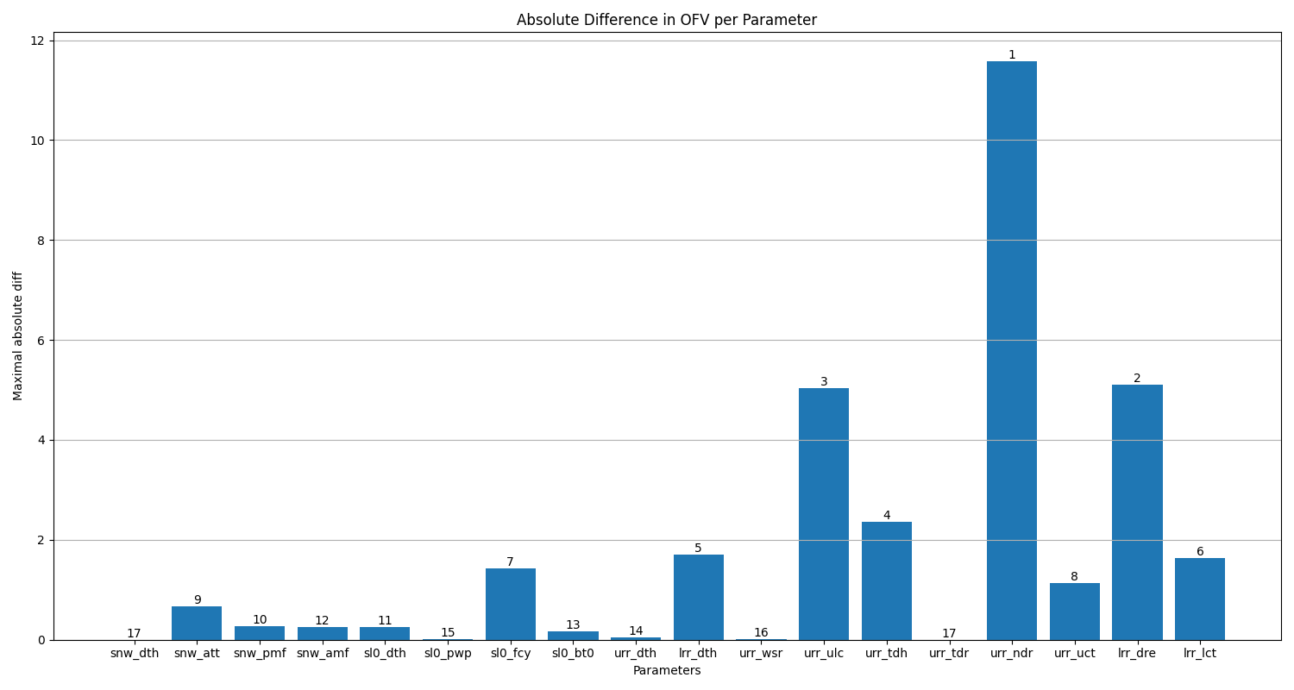
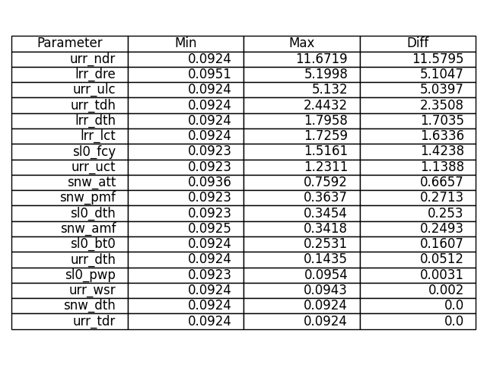
Local Sensitivity Analysis
Result – whole boundaries

Slide 6
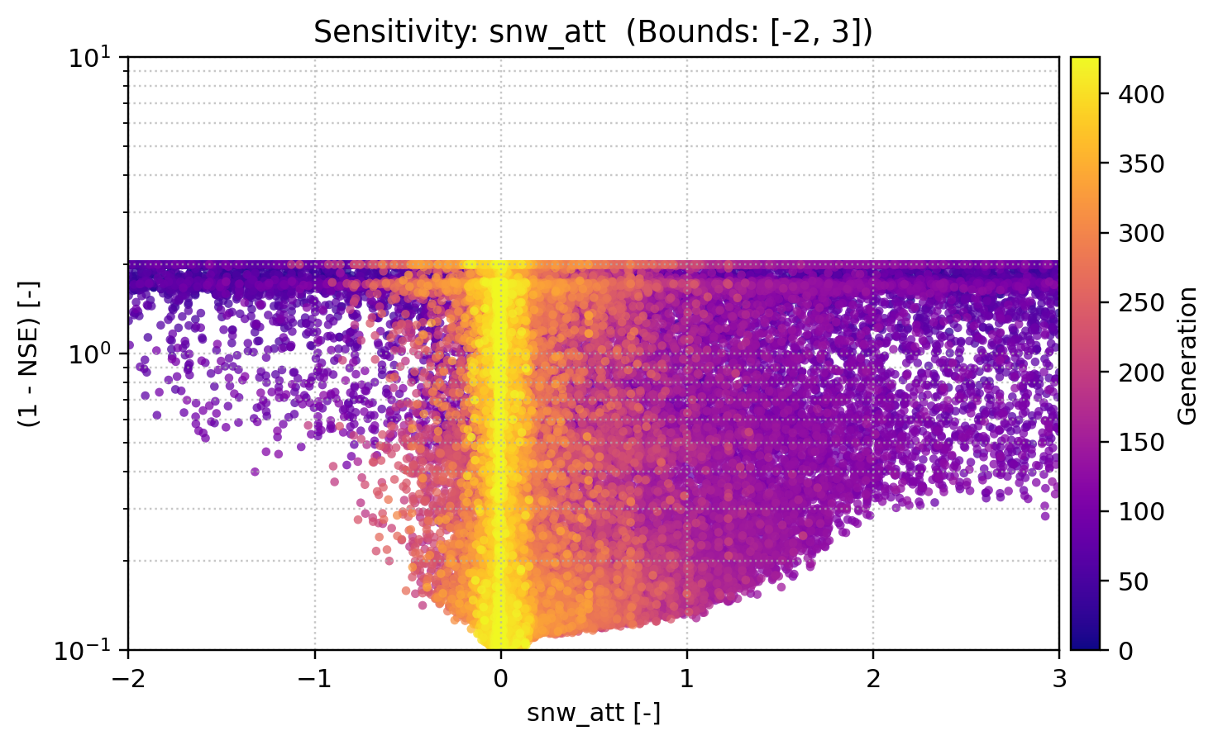
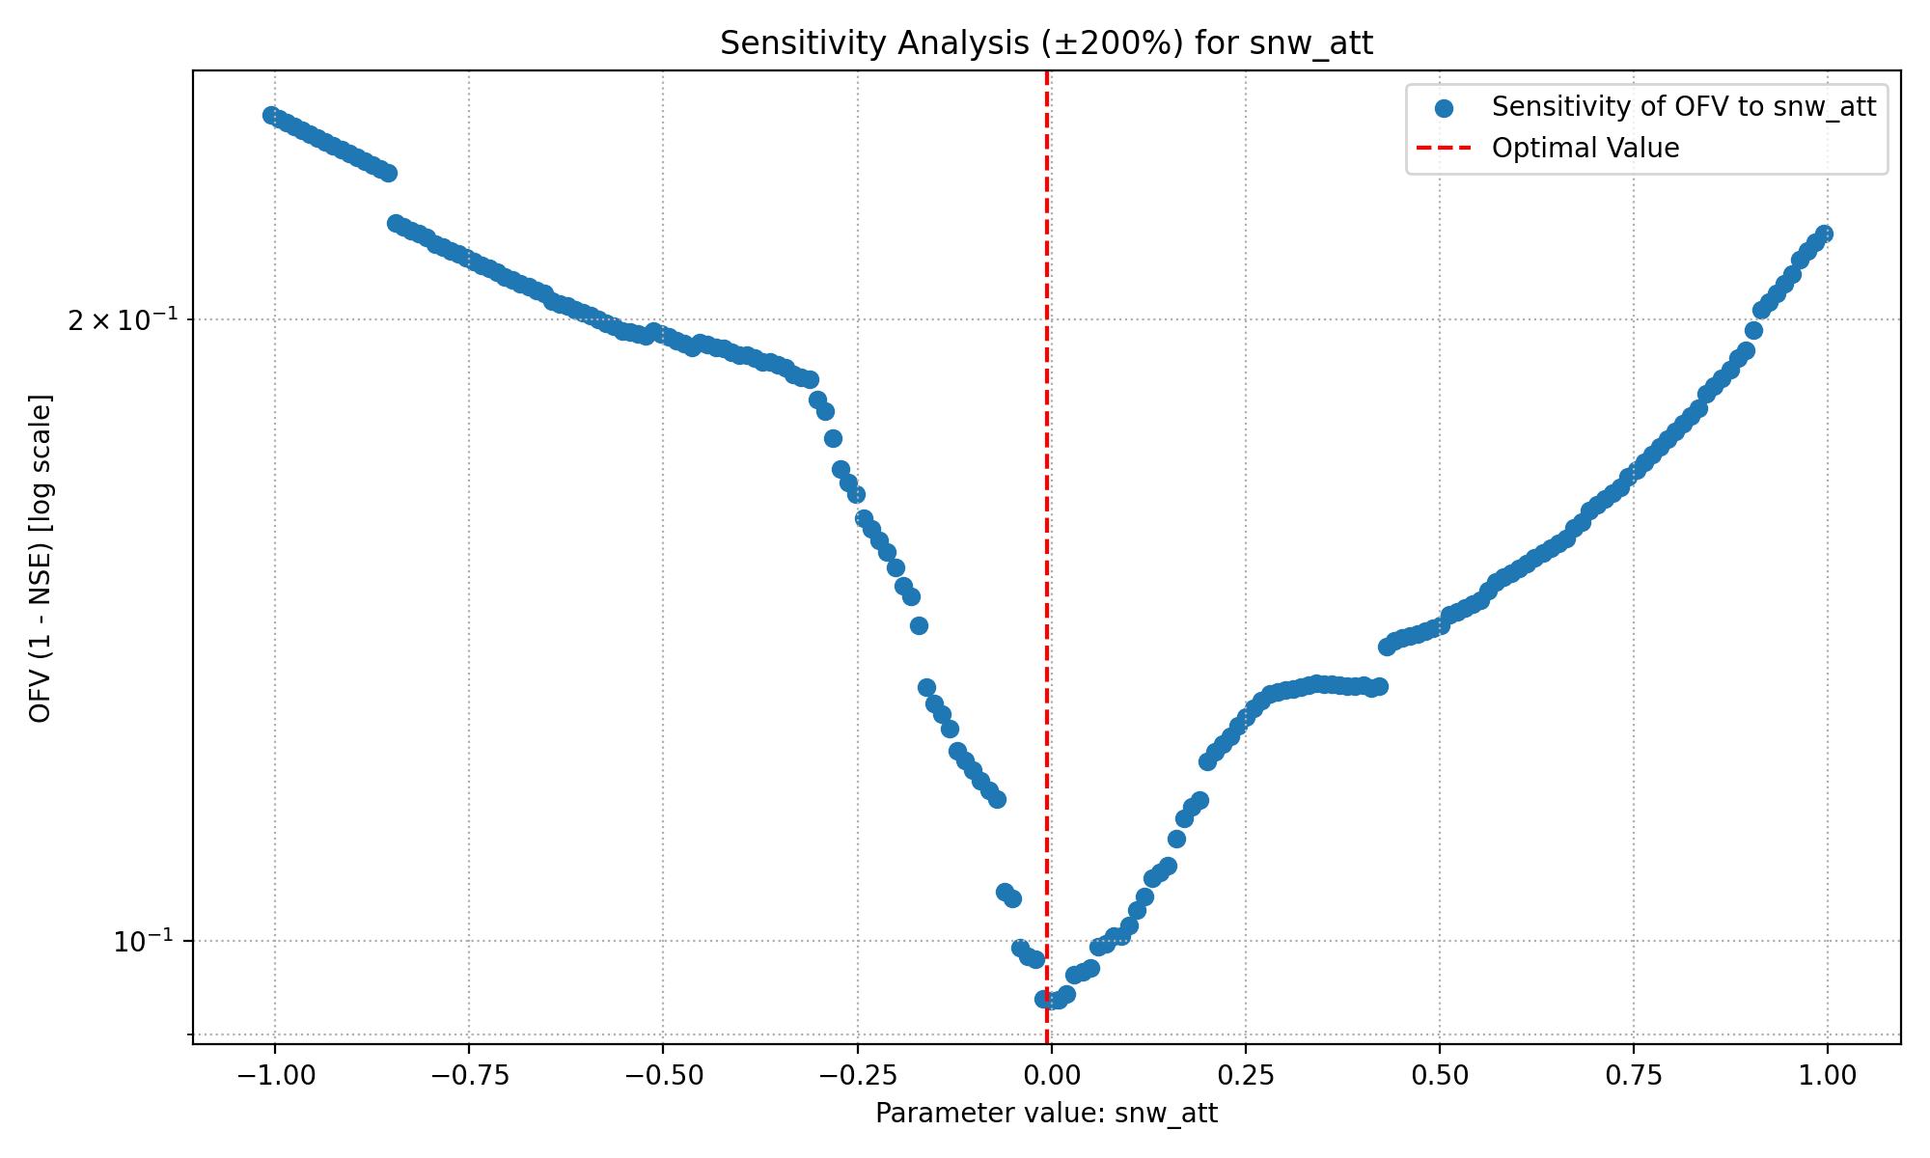
Snow fall/melt temperature threshold

Slide 7
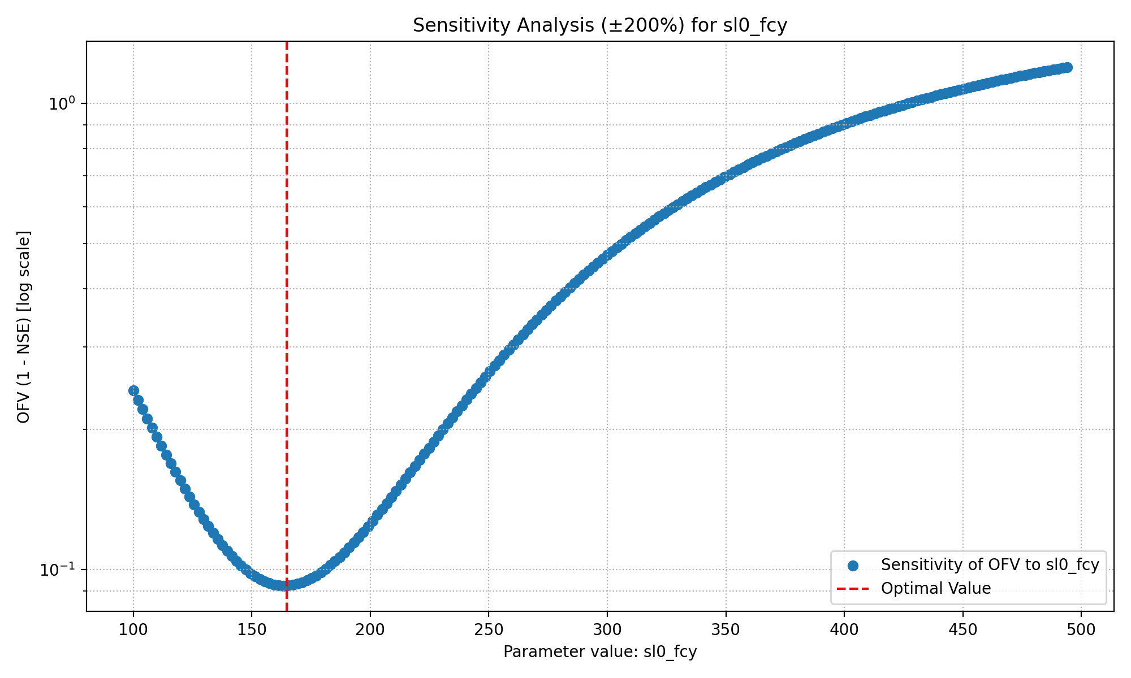
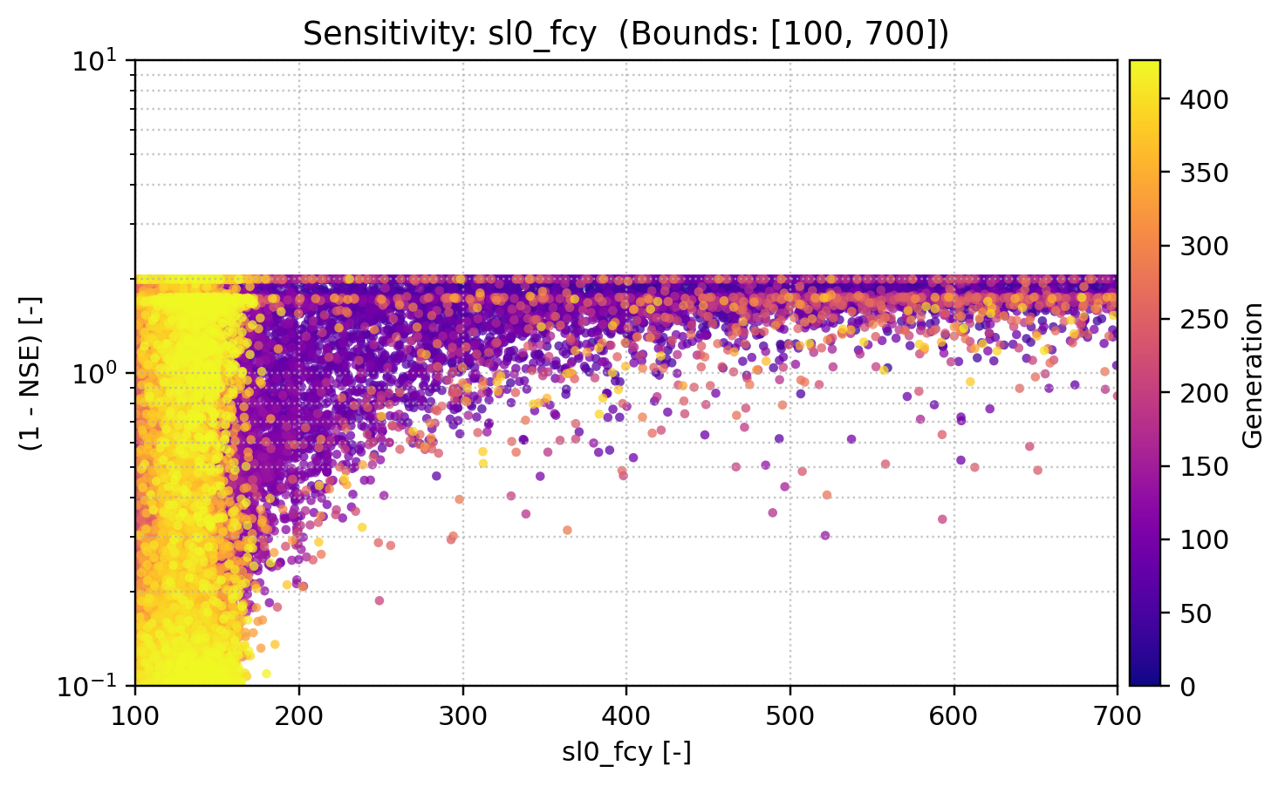
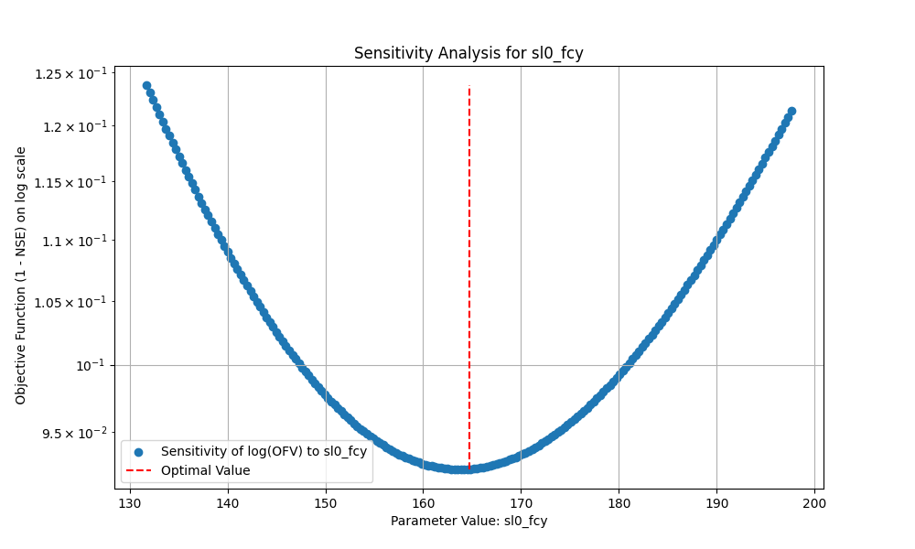
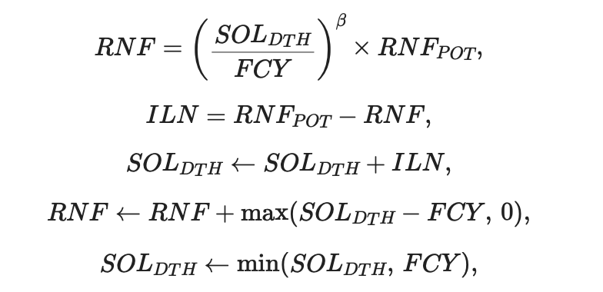
Soil field capacity

Slide 8
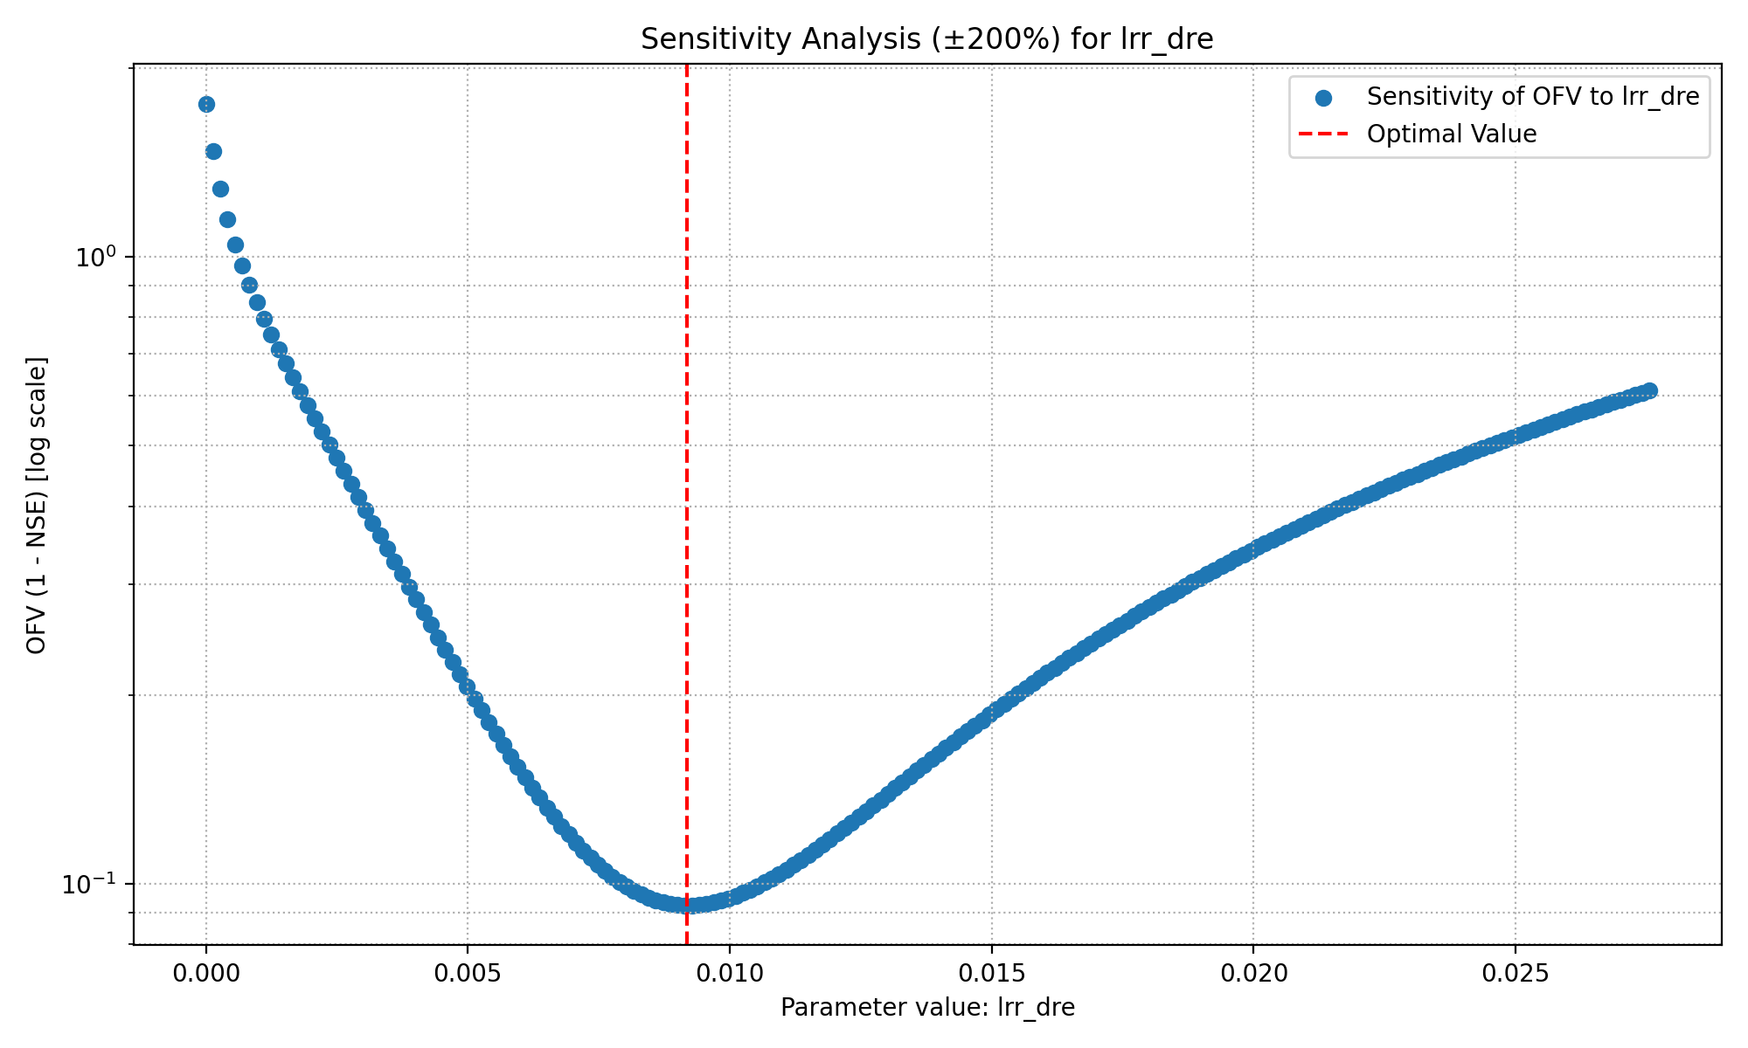
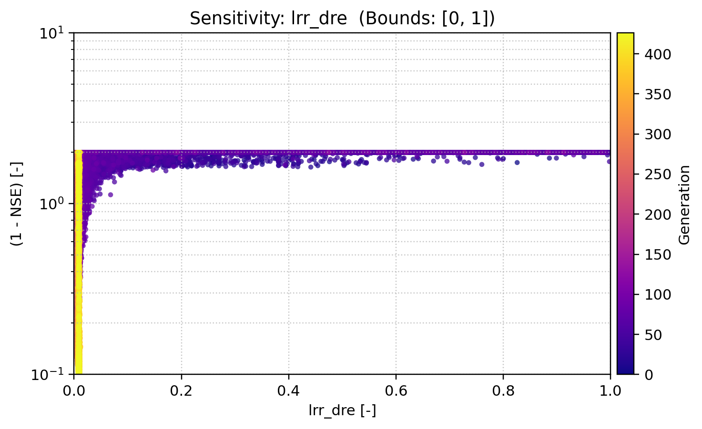
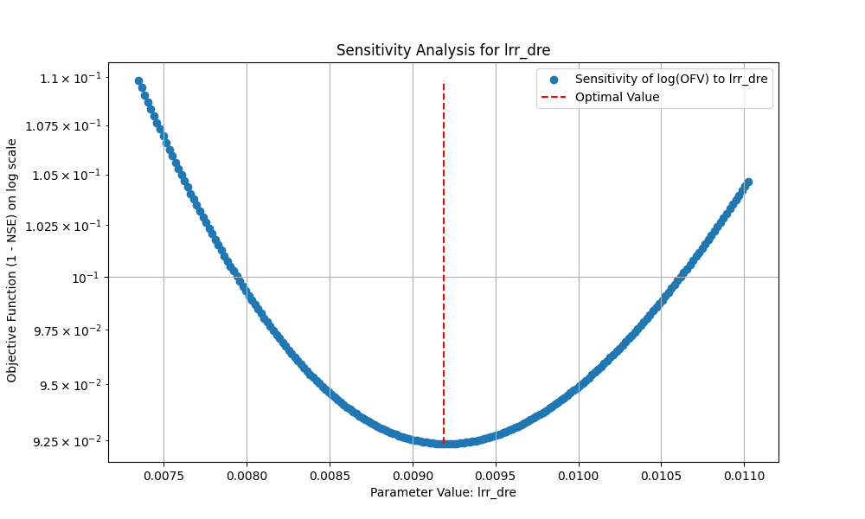
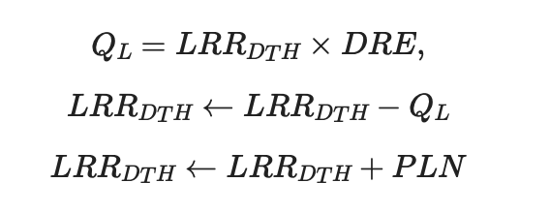
Sensitivity Analysis
Discharge Rate

Slide 9
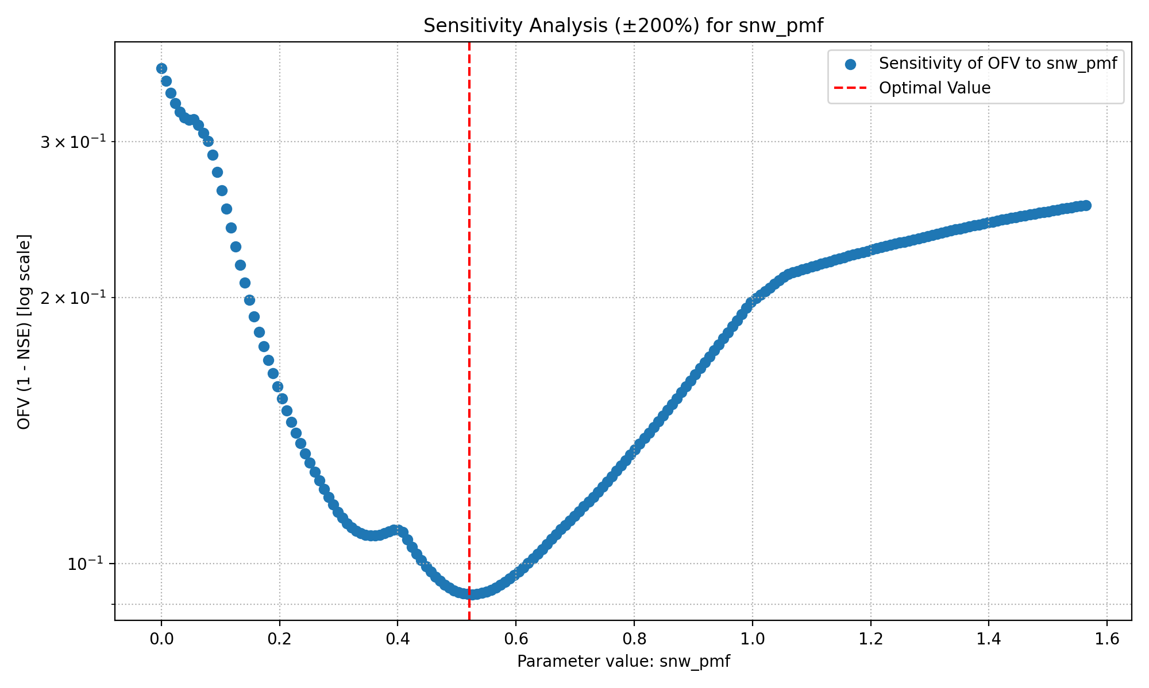
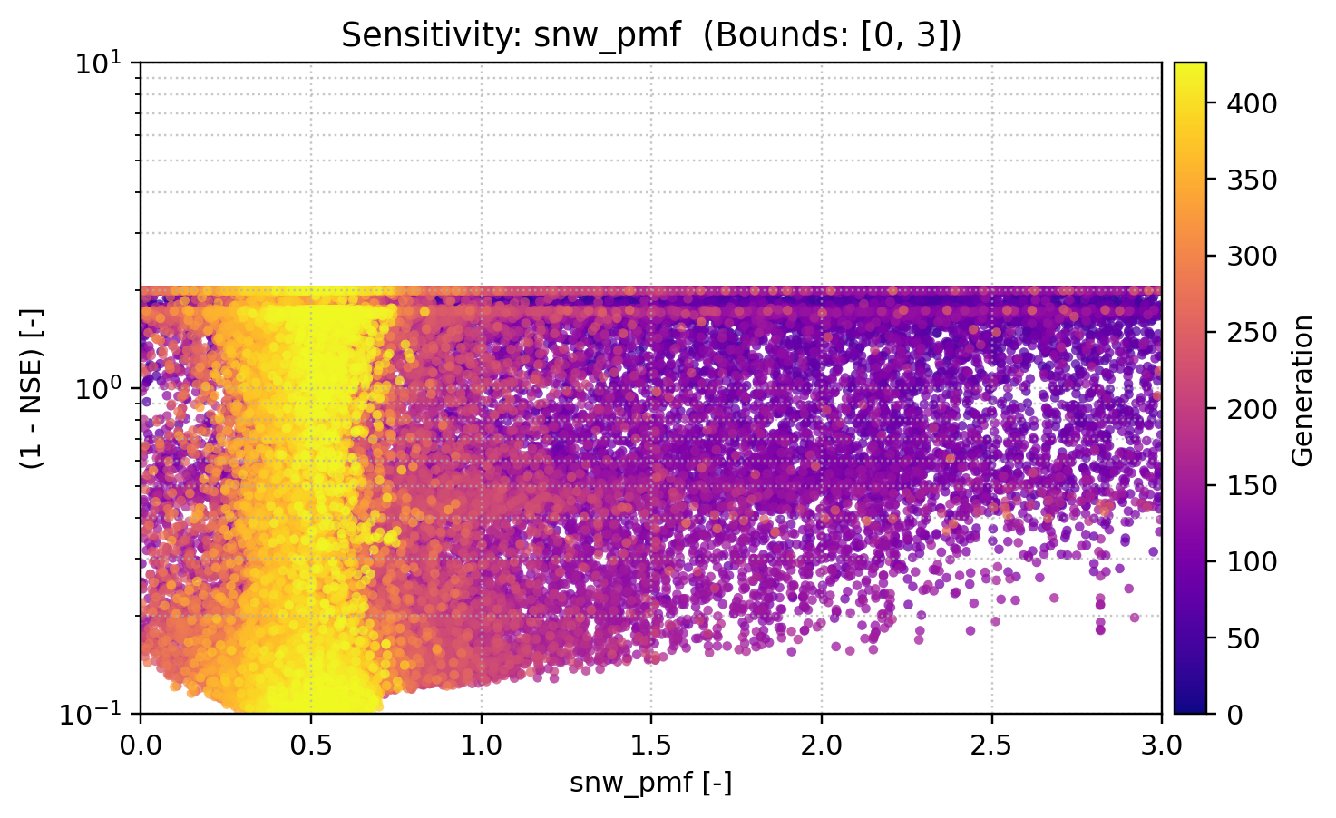
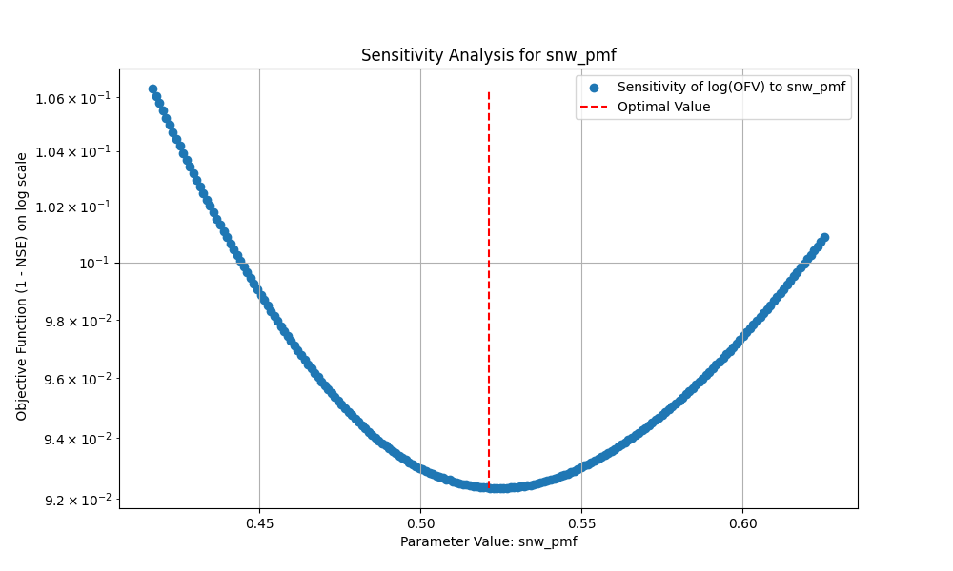
Precipitation melt factor

Slide 10
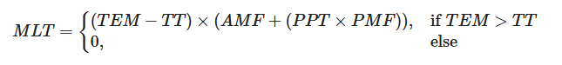
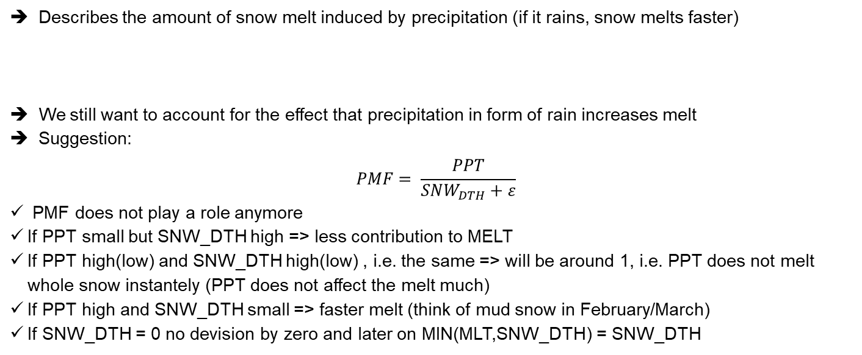
Trying to make a sensitive parameter not sensitive
Precipitation Melt Factor (PMF)
Describes the amount of snow melt induced by precipitation (if it rains, snow melts faster)
We still want to account for the effect that precipitation in form of rain increases melt
Suggestion:
$$PMF= \frac{PPT}{SNW_{DTH}+ε}$$
PMF does not play a role anymore
If PPT small but SNW_DTH high => less contribution to MELT
If PPT high(low) and SNW_DTH high(low) , i.e. the same => will be around 1, i.e. PPT does not melt whole snow instantely (PPT does not affect the melt much)
If PPT high and SNW_DTH small => faster melt (think of mud snow in February/March)
If SNW_DTH = 0 no devision by zero and later on MIN(MLT,SNW_DTH) = SNW_DTH

Slide 11
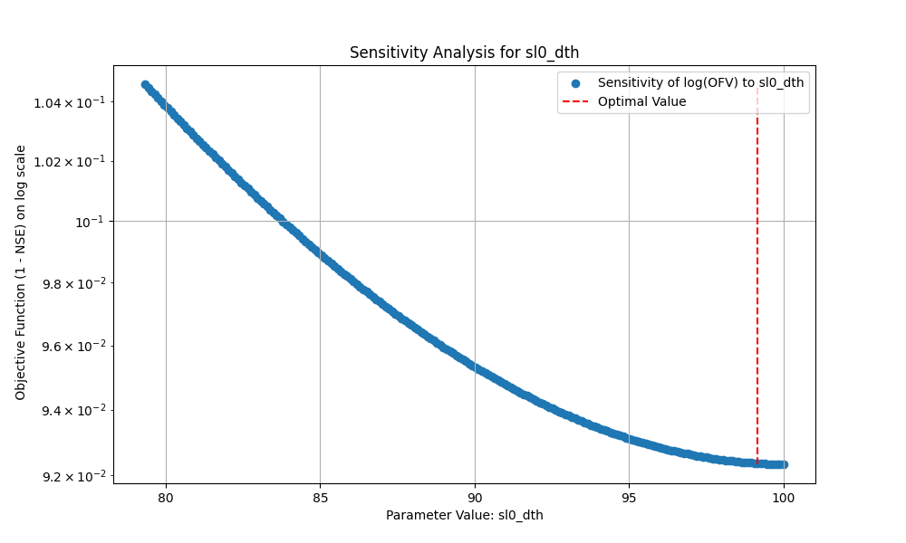
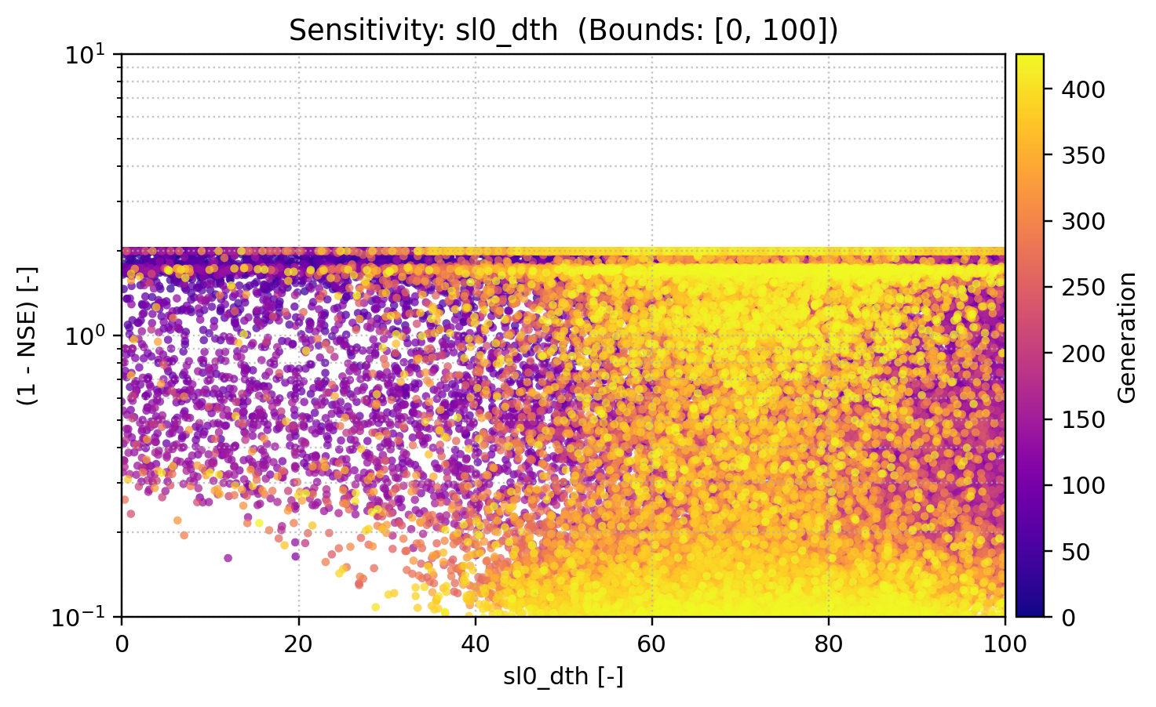
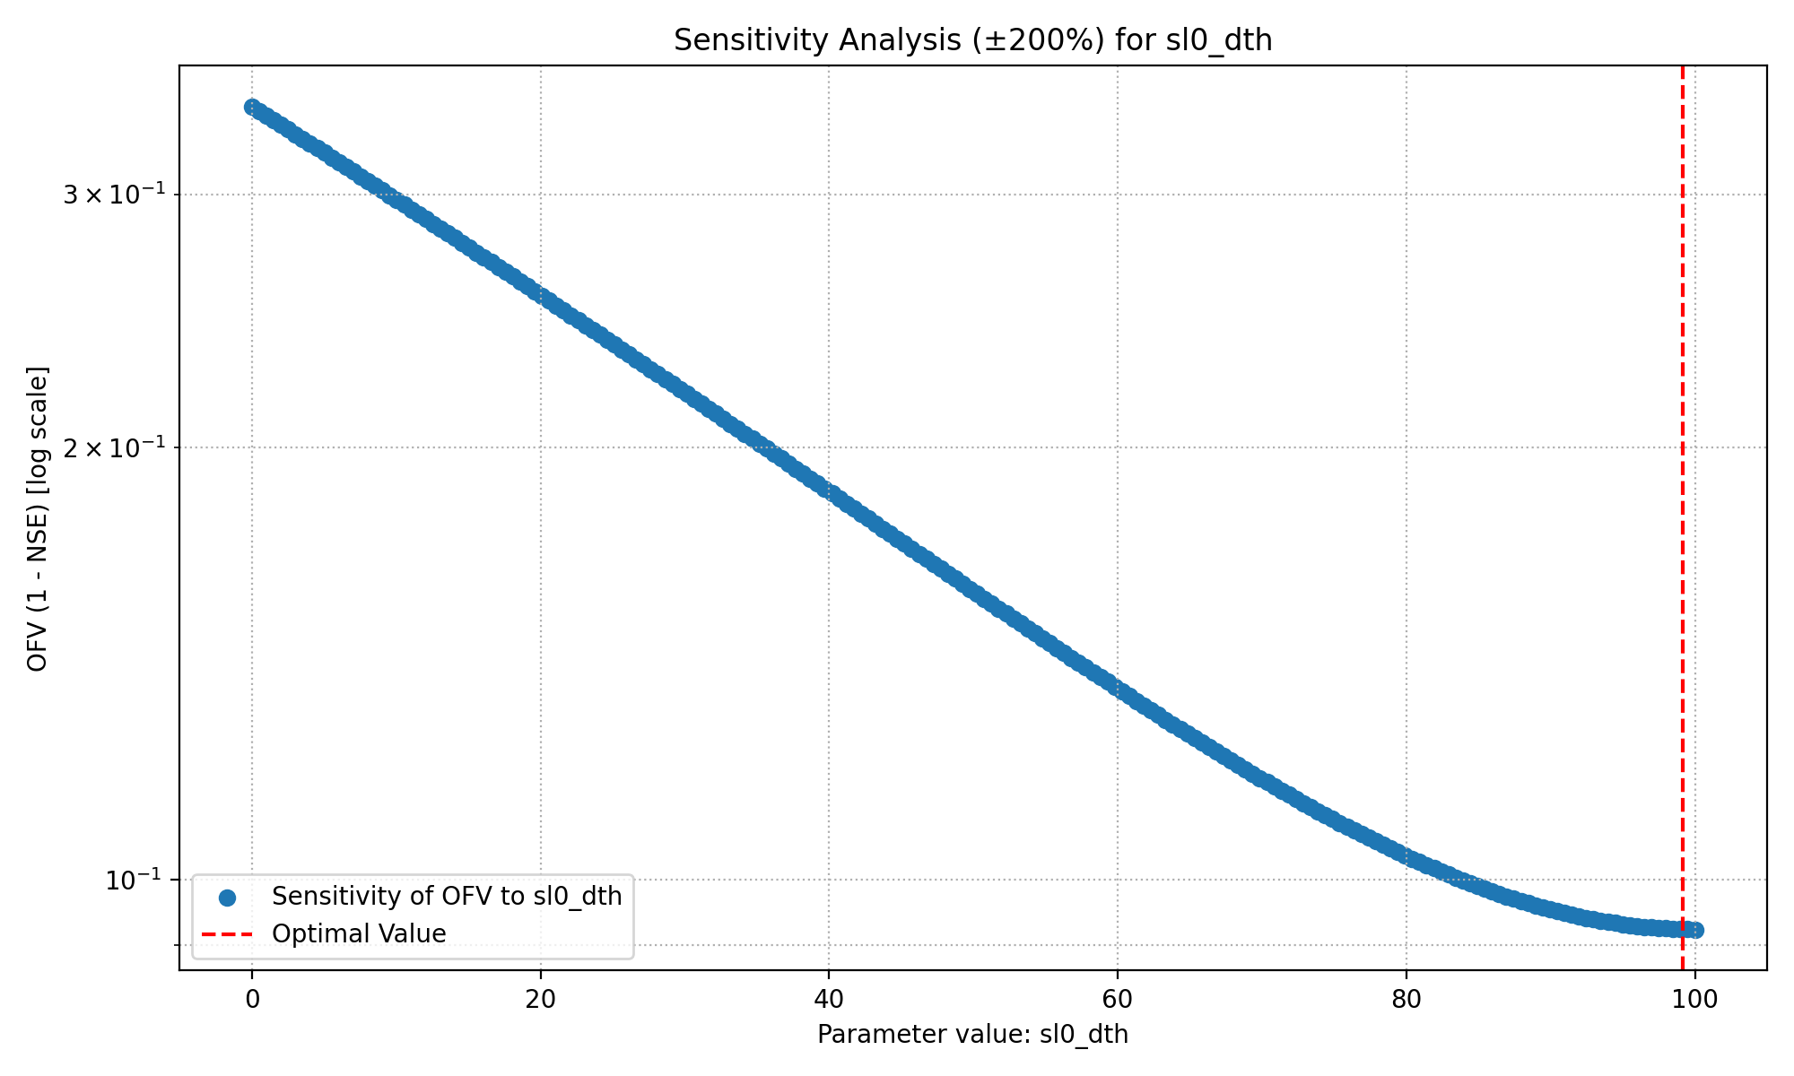
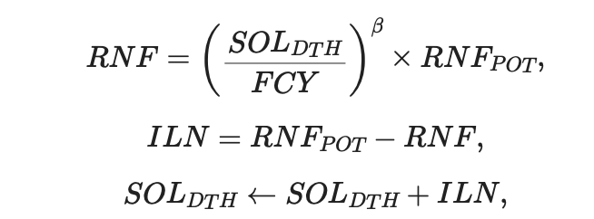
Soil initial moisture

Slide 12
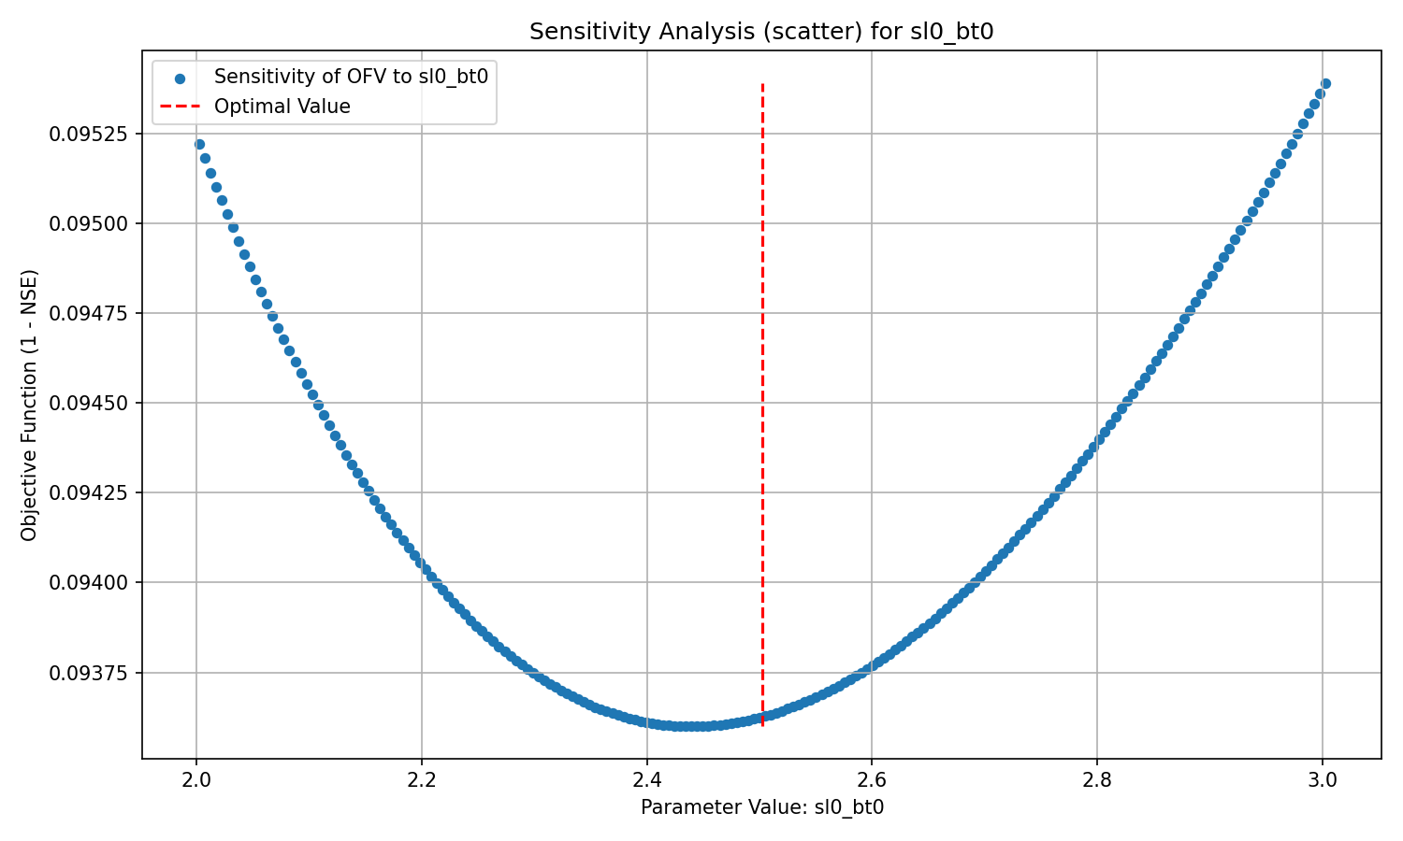
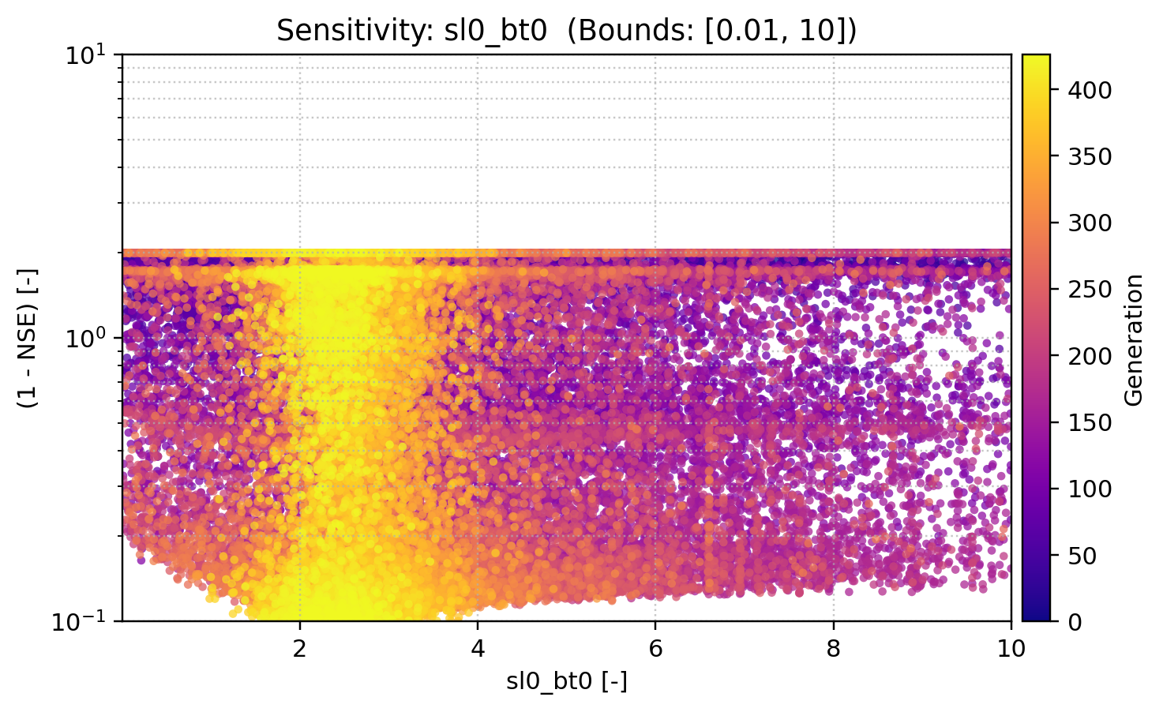
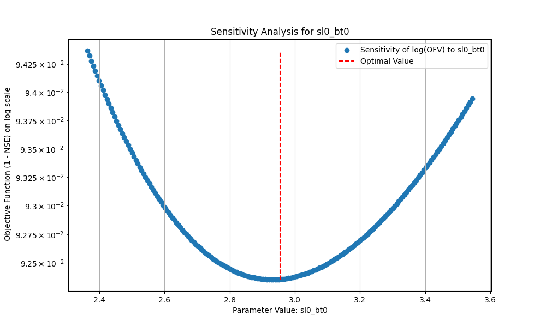
Soil Beta

Slide 13
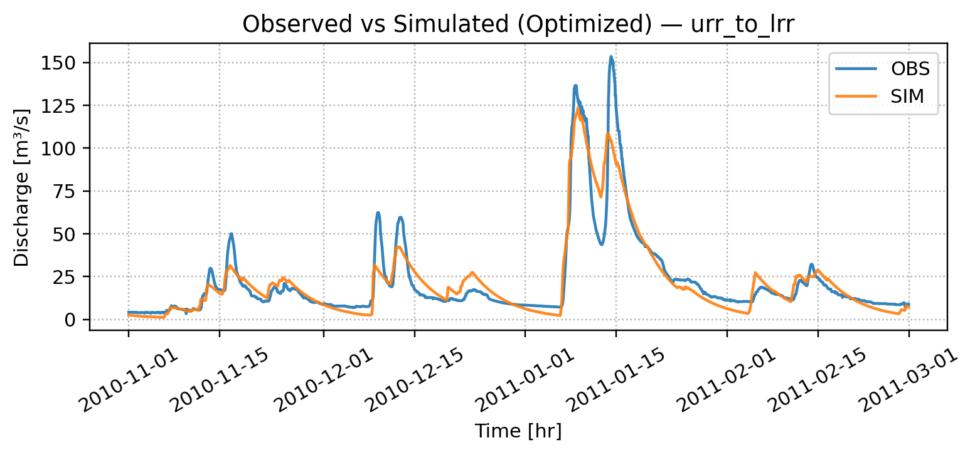
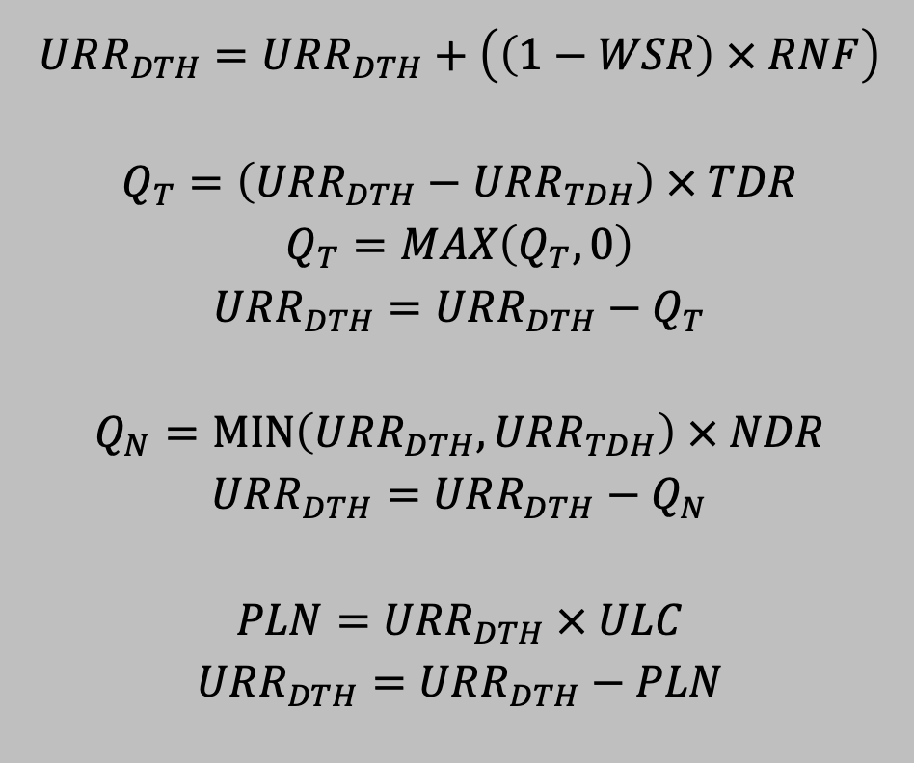
Recall
Turning URR Module (fast surface flow) off had the least impact
WSR = 0
URR_TDH​ = very large (≈1000)
TDR=0, NDR=0
ULC=1
Result:
PLN=RNF,Q_T=0,Q_N=0
URR acts as a pass-through to LRR, with no direct quickflow.
NSE = 0.8874

Slide 14
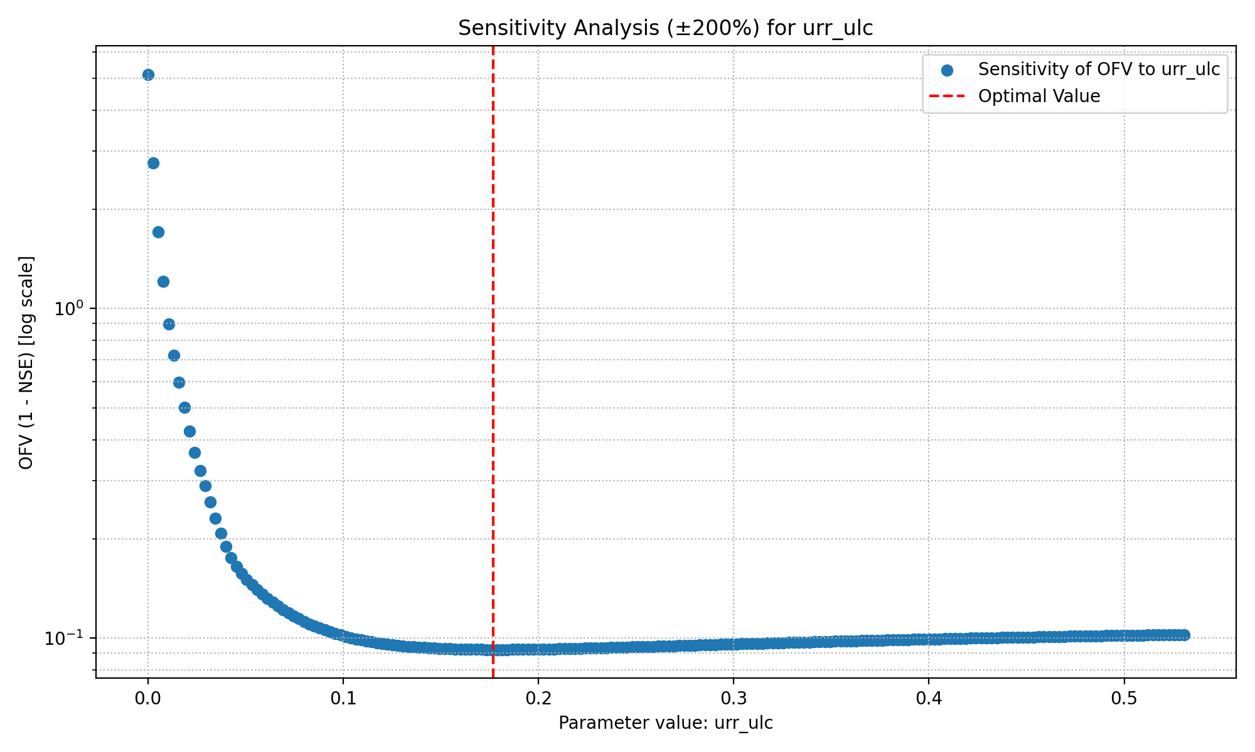
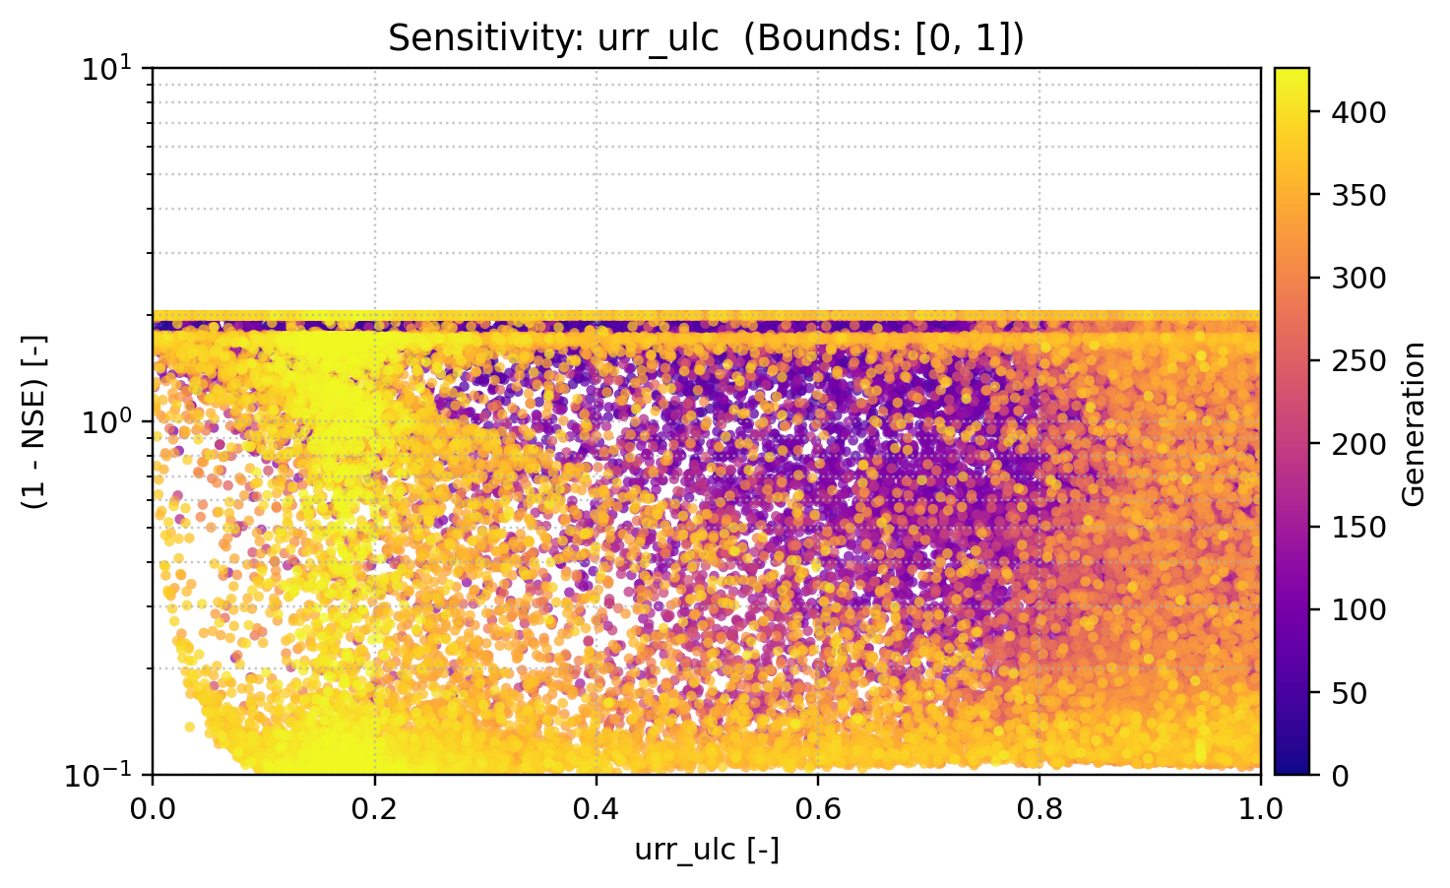
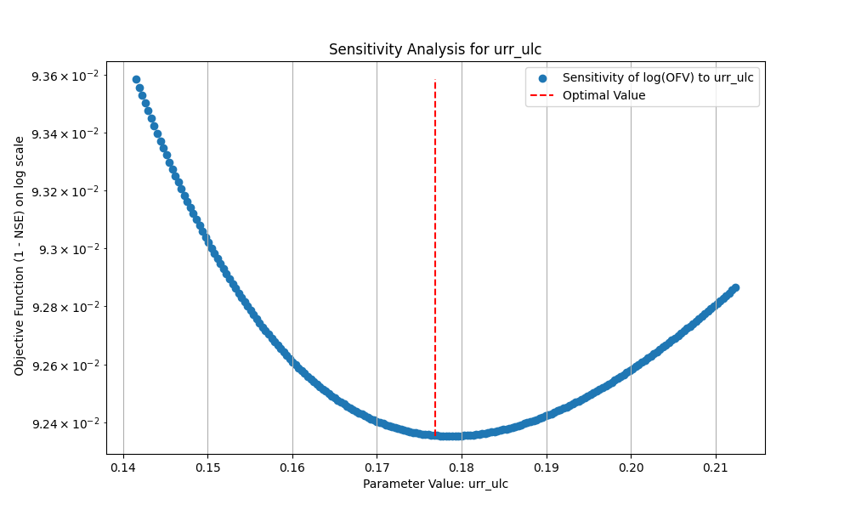
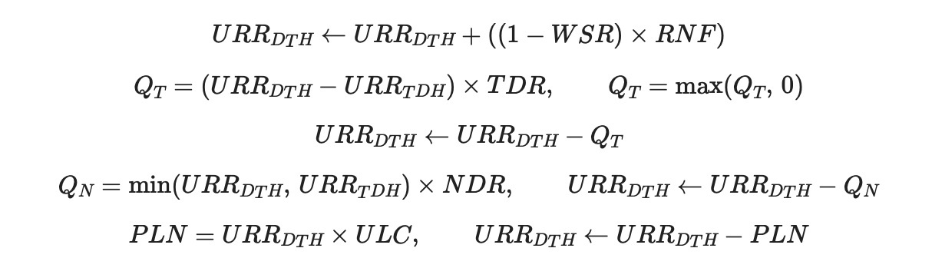
Percolation coefficient upper to lower

Slide 15
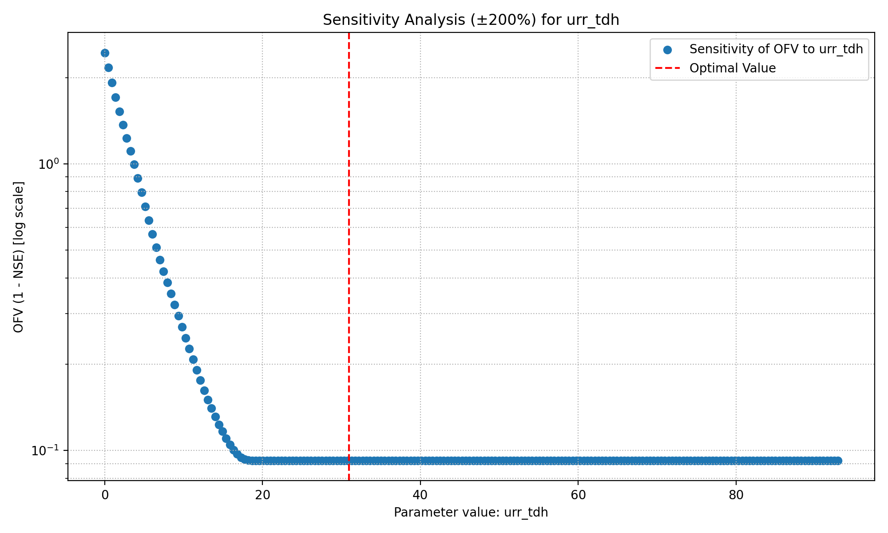
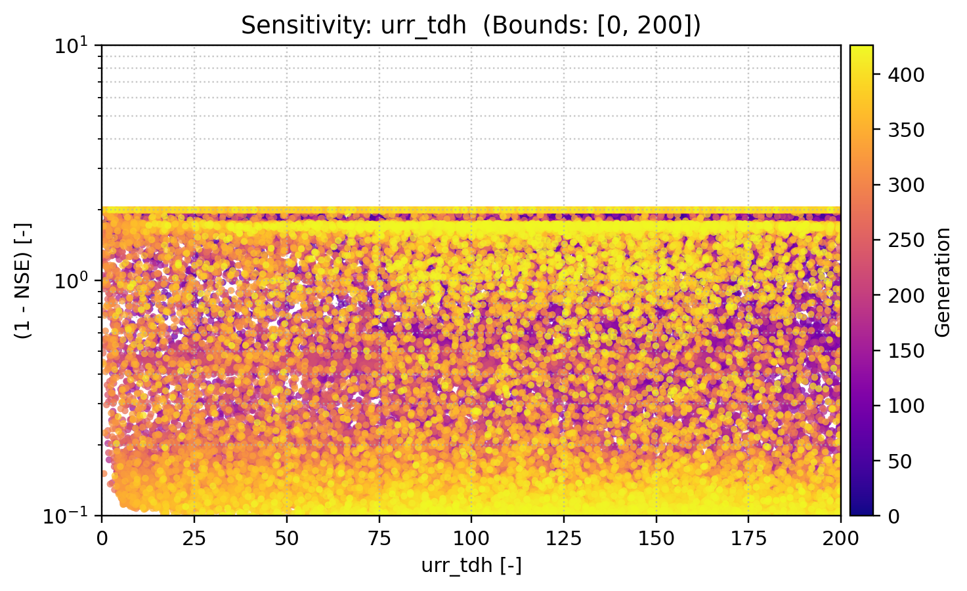
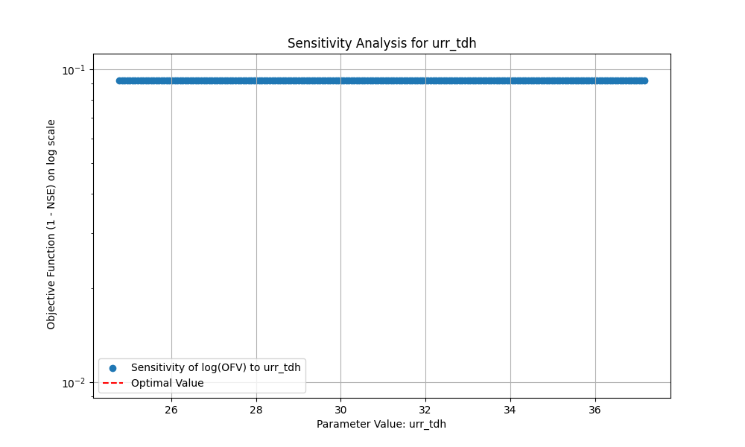
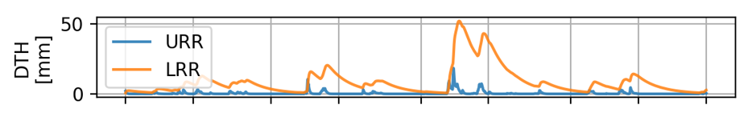
Upper reservoir threshold depth

Slide 16
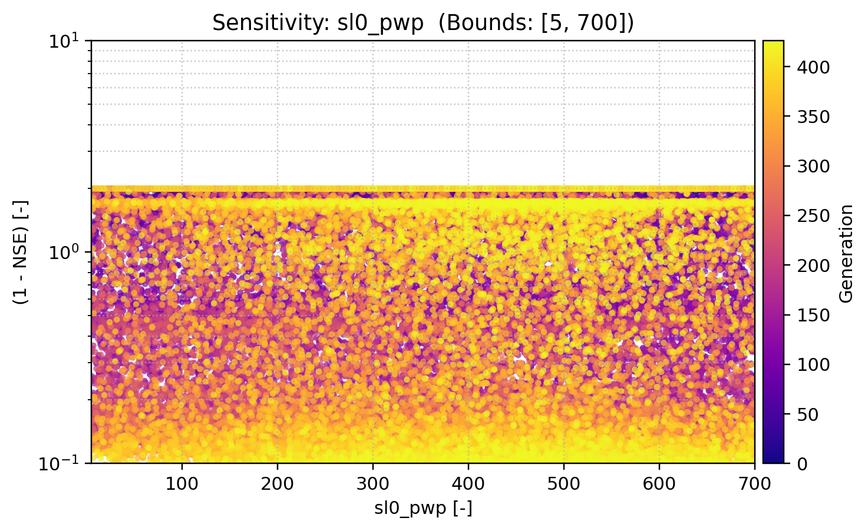
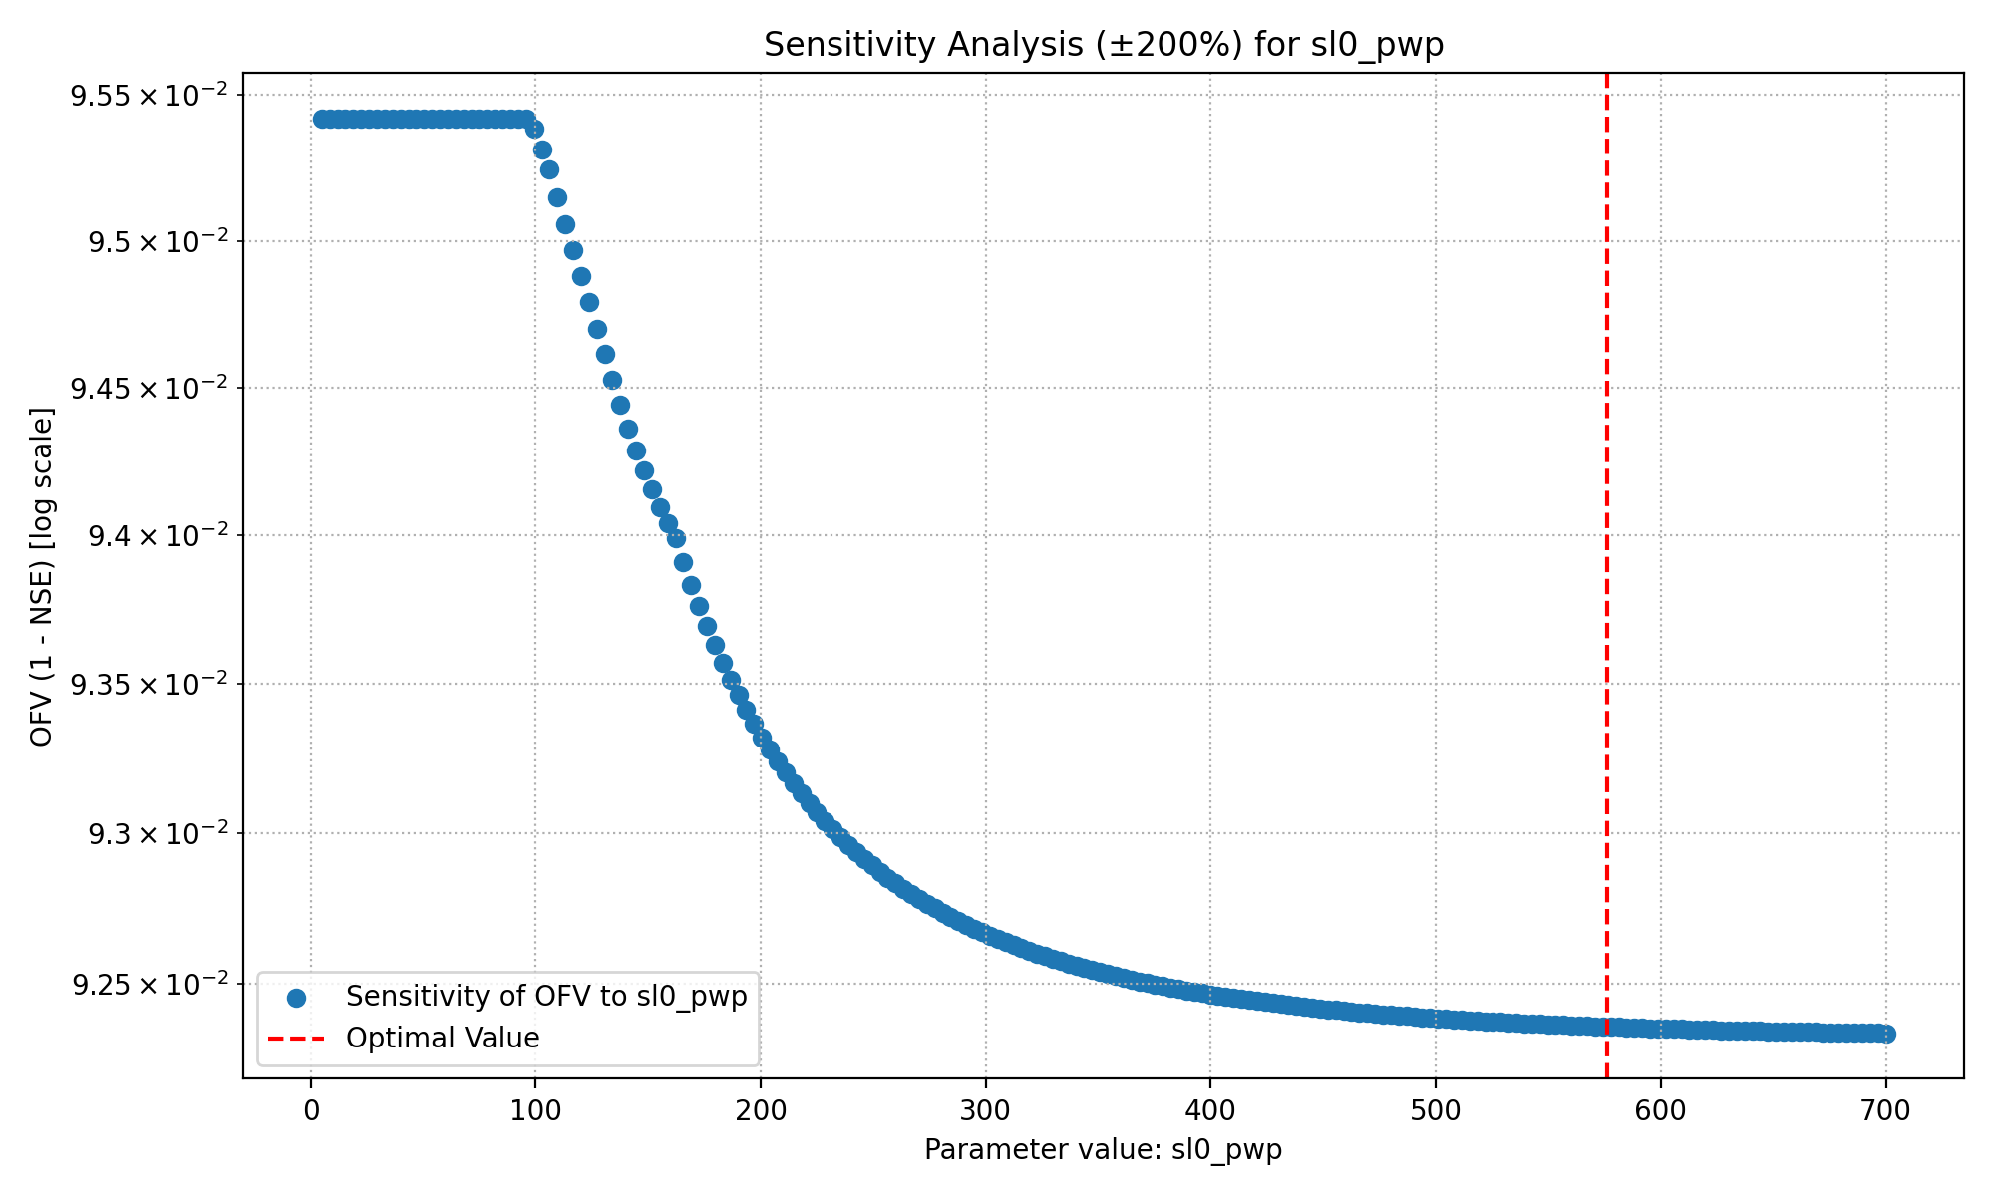
Soil permanent wilting point

Slide 17
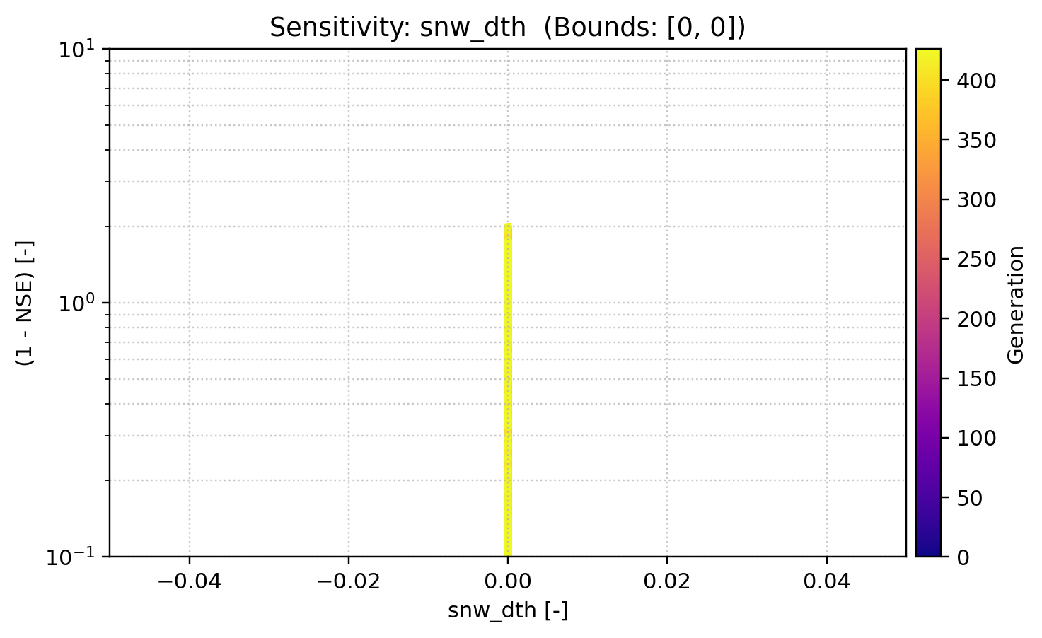
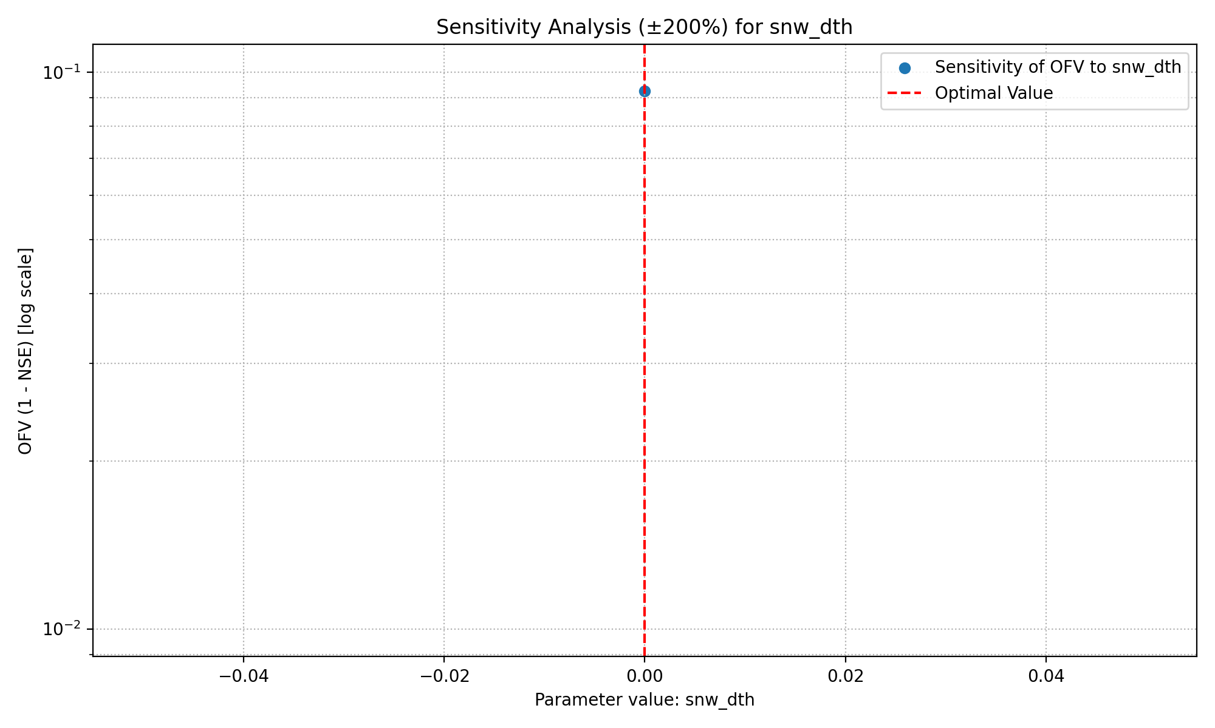
Snow initial depth

Slide 18
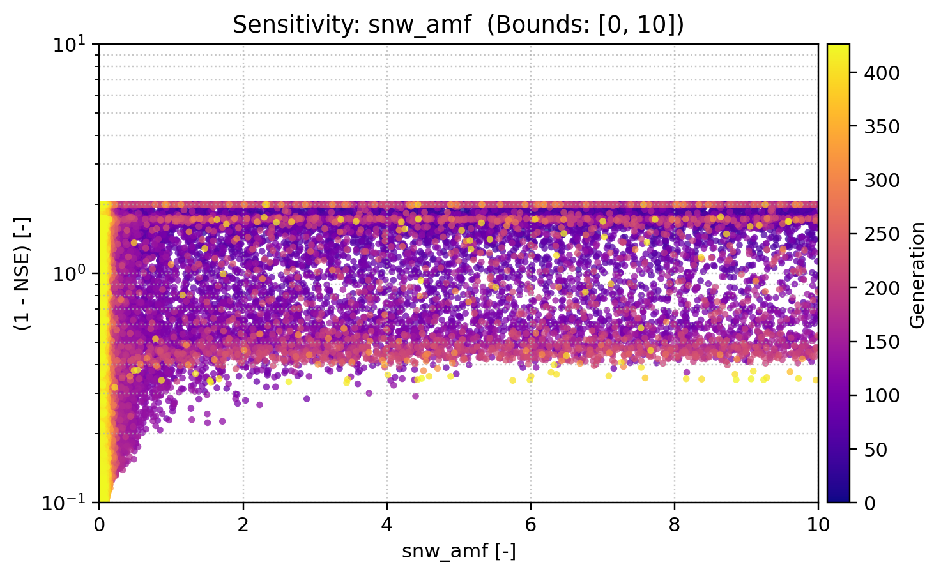
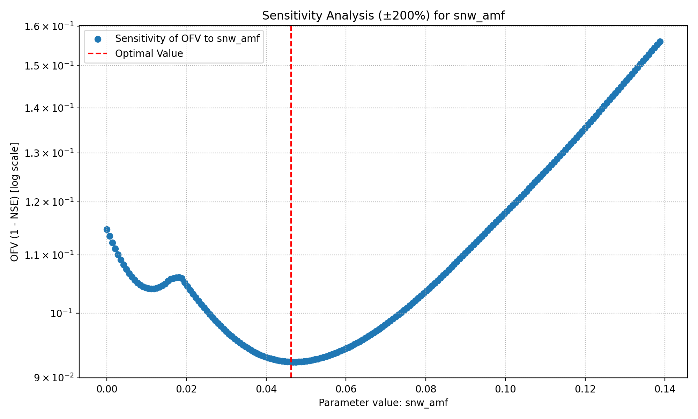
Precipitation melt air factor

Slide 19
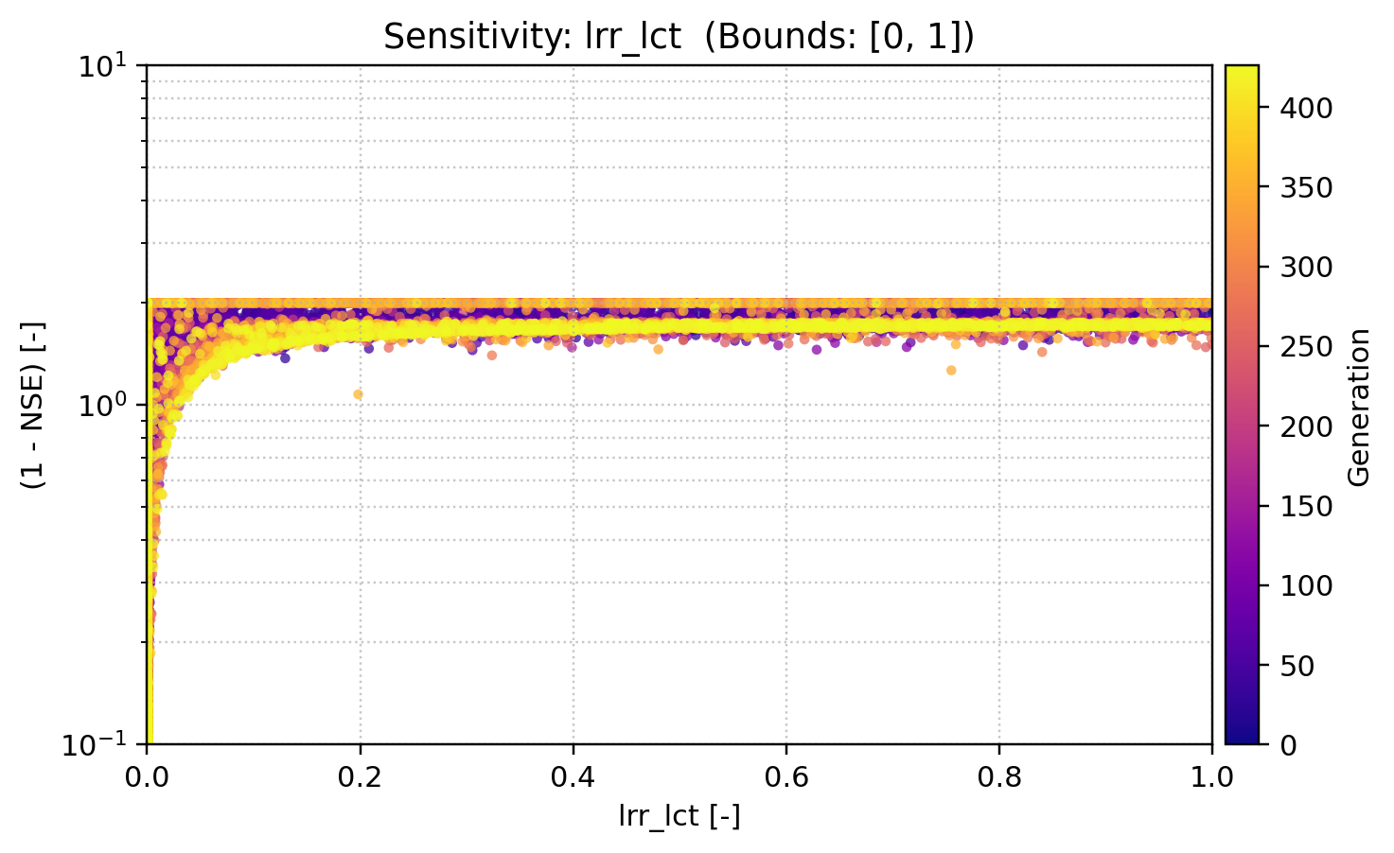
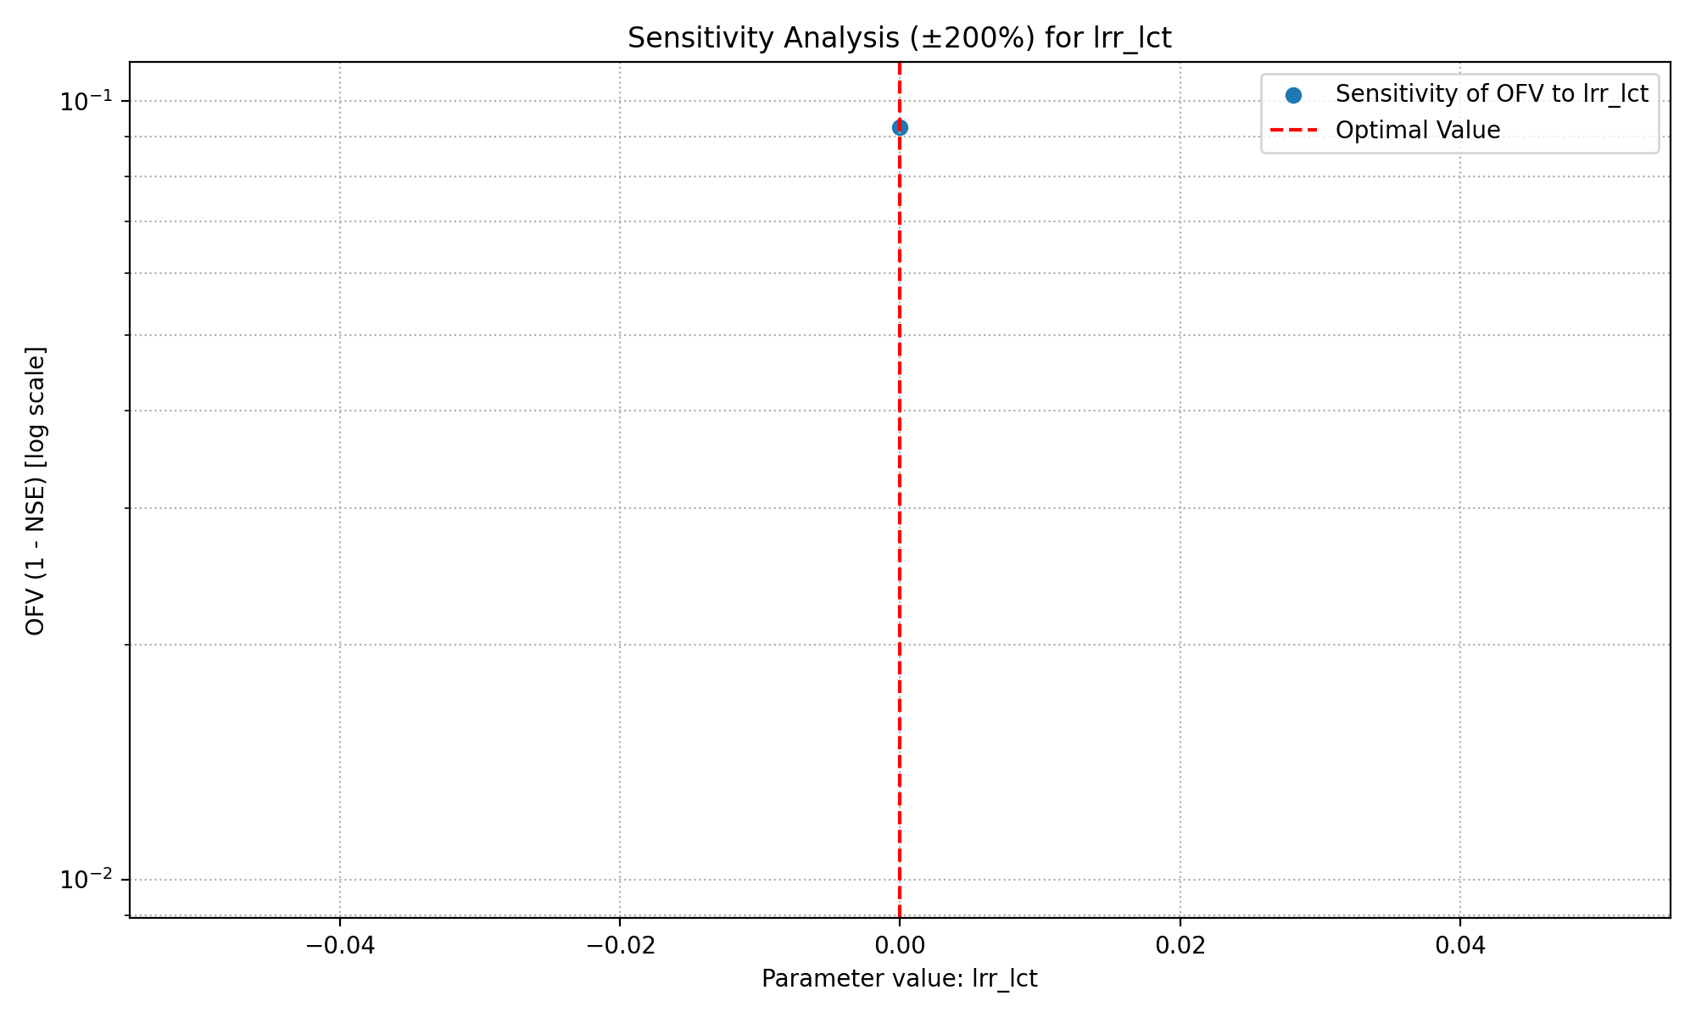
Lower reservoir runoff coefficient

Slide 20
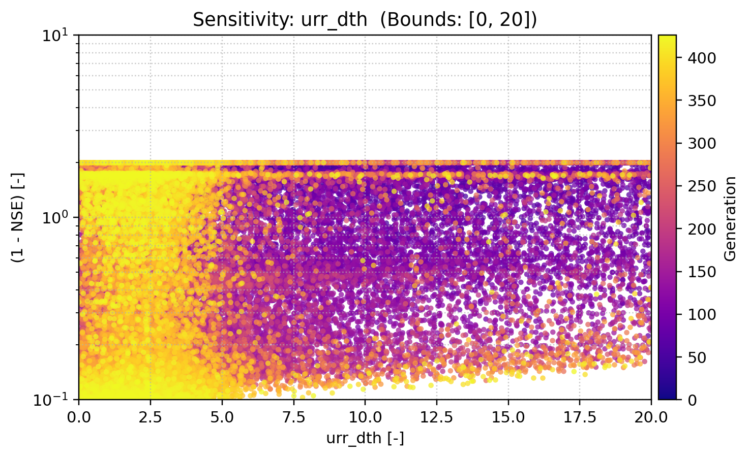
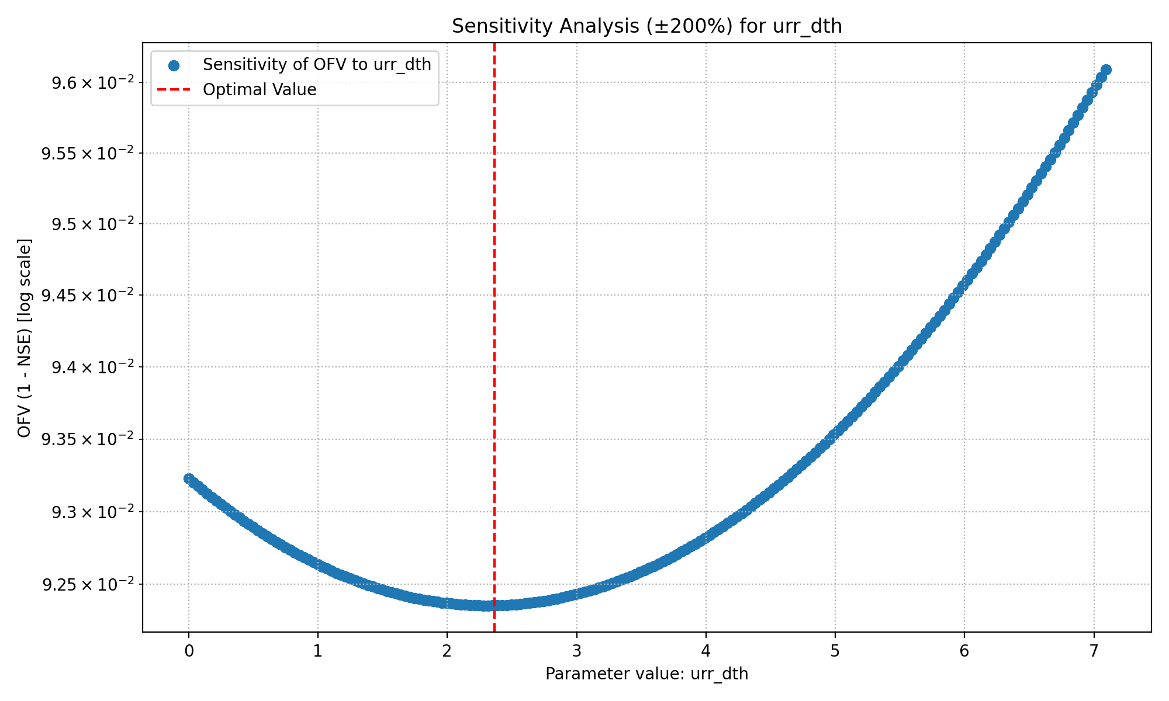
Storage initial upper reservoir

Slide 21


Upper reservoir threshold coefficient

Slide 22


Upper reservoir runoff coefficient

Slide 23


Upper reservoir runoff split ratio

Slide 24


Upper reservoir discharge to run-off coefficient

Slide 25


Storage initial lower reservoir

